Slide 1



Football IV
Produced by Dr. Mario | UNC STOR 538

Slide 2
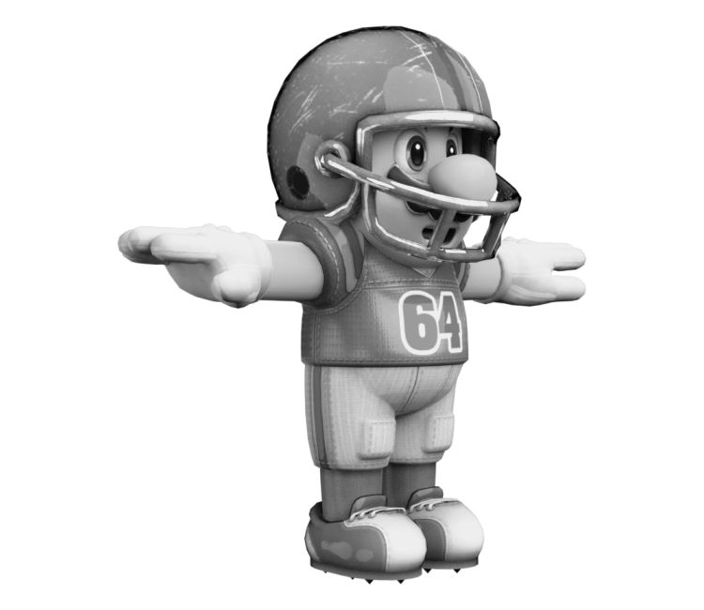
Football Decision Making
5 Key Decisions in Football
Fourth and 4 on Opponent’s 30 Yard Line. Field Goal or Punt?
Fourth and 4 on Own 30 Yard Line. Attempt or Punt?
Gained 7 Yards on First Down From Own 30 Yard Line and Defense
Was Offsides. Accept the Penalty?
Opponent Gained 0 Yards on Run on First Down. They were
Offside. Accept the Penalty?
Optimal Run/Pass Mixture on First Down?
Decision Based on States of Football
Best Decision Maximizes the Expected Margin
Look at Later
$$Expected Margin=V(Down, Yards For 1st Down, Yard Line)$$

Slide 3
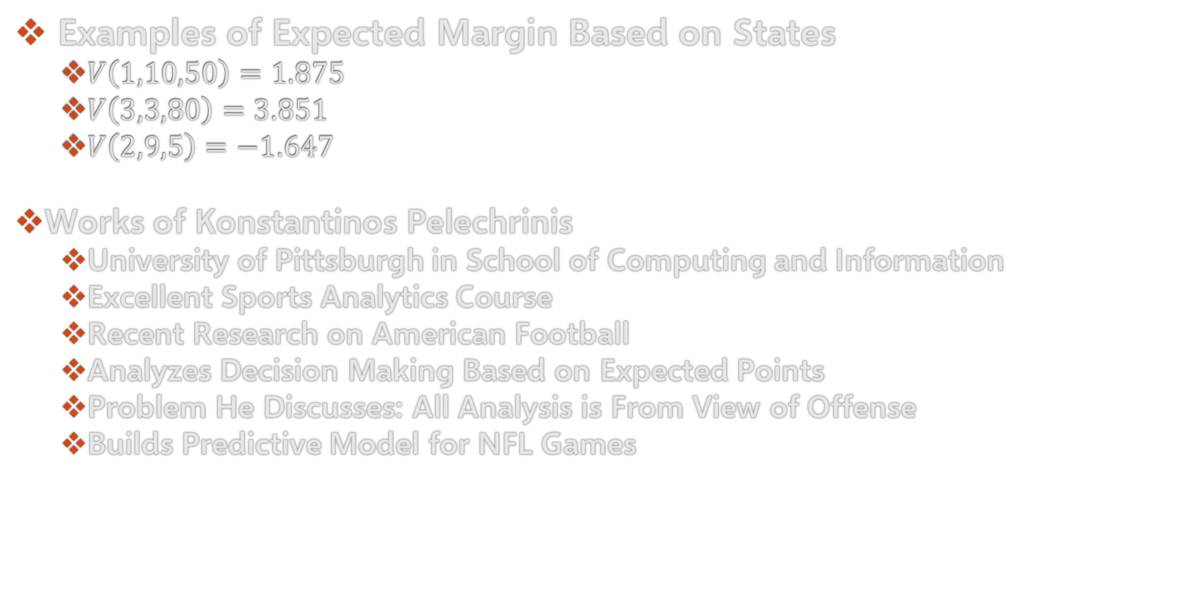
Football Decision Making
Examples of Expected Margin Based on States
$V\left(1,10,50\right)=1.875$
$V\left(3,3,80\right)=3.851$
$V\left(2,9,5\right)=−1.647$
Works of Konstantinos Pelechrinis
University of Pittsburgh in School of Computing and Information
Excellent Sports Analytics Course
Recent Research on American Football
Analyzes Decision Making Based on Expected Points
Problem He Discusses: All Analysis is From View of Offense
Builds Predictive Model for NFL Games

Slide 4
Football Decision Making
Fourth and 4 on Opponent’s 30 Yard Line
Evaluate Expected Margin if Team Attempts to Get 1st Down
Evaluate Expected Margin if Team Attempts Field Goal
$$E\left[Margin | Go For It\right]=P\left(Success\right)E\left[Margin | Success\right]+P\left(Failure\right)E\left[Margin | Failure\right]$$
$$=P\left(Success\right)×V\left(1,10,75\right)−P\left(Failure\right)×V(1,10,28)$$
What Assumptions are
Being Made Here?
$$E\left[Margin | Field Goal\right]=P\left(Success\right)E\left[Margin | Success\right]+P\left(Failure\right)E\left[Margin | Failure\right]$$
$$=P\left(Success\right)×(3−V(1,10,27))−P\left(Failure\right)×V(1,10,37)$$
What Assumptions are
Being Made Here?

Slide 5
Football Decision Making
Fourth and 4 on Opponent’s 30 Yard Line
Modeling Probability of Making Field Goal
Let p Represent the Probability of Making a Field Goal
Assumption: Distance Effects p
Let d Represent the Distance of the Field Goal
Consider the Linear Regression
Consider the Logistic Regression
What Other Considerations Should Be Made?
$$p=β_{0}+β_{1}×d+ε$$
What is the Problem Here?
$$\log\left(\frac{p}{1−p}\right)=β_{0}+β_{1}×d$$

Slide 6
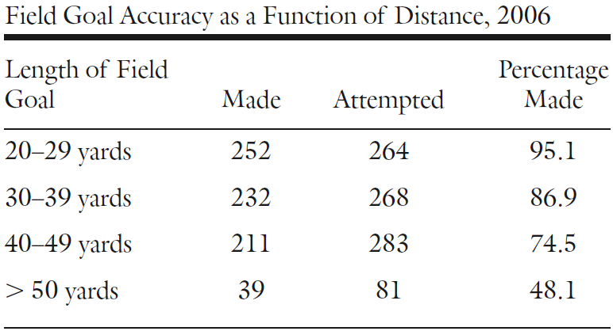
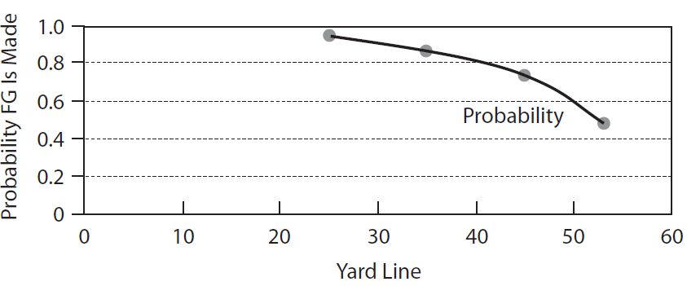
Football Decision Making
Fourth and 4 on Opponent’s 30 Yard Line
Modeling Probability of Making Field Goal
Raw Aggregated Data From 2006
Logistic Regression Smooths This Relationship?

Slide 7
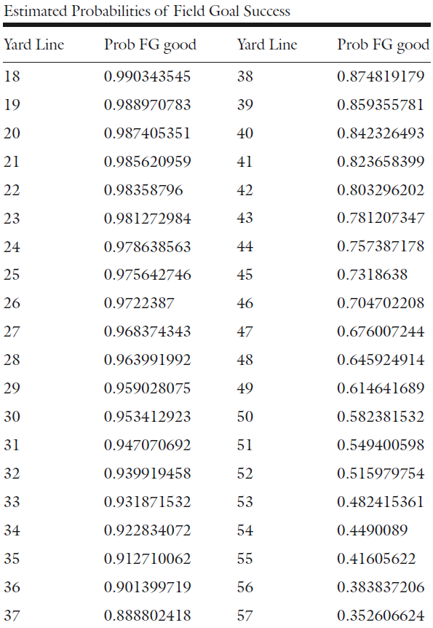

Football Decision Making
Fourth and 4 on Opponent’s 30 Yard Line
Modeling Probability of Making Field Goal
Results from Logistic Regression
Expected Margin for States of Interest
Expected Margin Under Field Goal
$$\log\left(\frac{p}{1−p}\right)=7.05−0.134×d$$
$$V\left(1,10,75\right)=3.884$$
$$V\left(1,10,28\right)=0.336$$
$$V\left(1,10,27\right)=0.266$$
$$V\left(1,10,37\right)=0.979$$
$$0.676×\left(3−0.266\right)−0.324×0.978=1.531$$

Slide 8
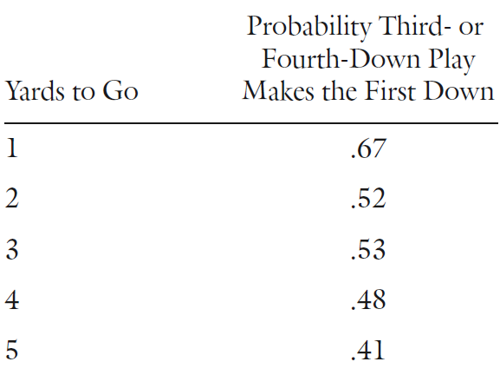
Football Decision Making
Fourth and 4 on Opponent’s 30 Yard Line
Modeling Probability of Making Field Goal
When to Go for First Down
According to Football Reference
$$P\left(Success\right)×3.884−(1−P\left(Success\right))×0.336≥1.531$$
$$P\left(Success\right)×3.884−0.336+0.336×P\left(Success\right)≥1.531$$
$$4.22×P\left(Success\right)≥1.867$$
$$P\left(Success\right)≥0.442$$

Slide 9
Football Decision Making
Fourth and 4 on Our 30 Yard Line
Evaluate Expected Margin If We Punt
Evaluate Expected Margin If We Go For It
Need 67.8% Probability to Justify Going for First Down
$$E\left[Margin | Punt\right]=−V\left(1,10,30\right)=−0.48$$
$$E\left[Margin | Punt\right]=−P\left(5 YD\right)×V\left(1,10,65\right)−P\left(10 YD\right)×V\left(1,10,55\right)−⋯−P\left(65 YD\right)×V(1,10,5)$$
Consideration of All Possible Punt Scenarios
Assuming the Punt is Not Blocked
$$E\left[Margin | Go For It\right]=P\left(Success\right)×V\left(1,10,35\right)−P\left(Failure\right)×V\left(1,10,68\right)$$

Slide 10
Football Decision Making
Simpler Scenarios
Gained 7 Yards on 1st Down from 30 Yard Line and Defense Offsides
Opponent Ran for 0 Yards on 1st Down on 30 Yard Line and Offense Offsides
Do You See Any Problems With Using This to Make Decisions?
Don’t Accept Penalty
$$V\left(2,3,37\right)=0.956$$
Accept Penalty
$$V\left(1,5,35\right)=0.983$$
Don’t Accept Penalty
$$V\left(2,10,30\right)=0.115$$
Accept Penalty
$$V\left(1,15,25\right)=−0.057$$

Slide 11

Final Inspiration
This is no democracy.
It is a dictatorship.
I am the law.
- Coach Herman Boone

